Slide 1
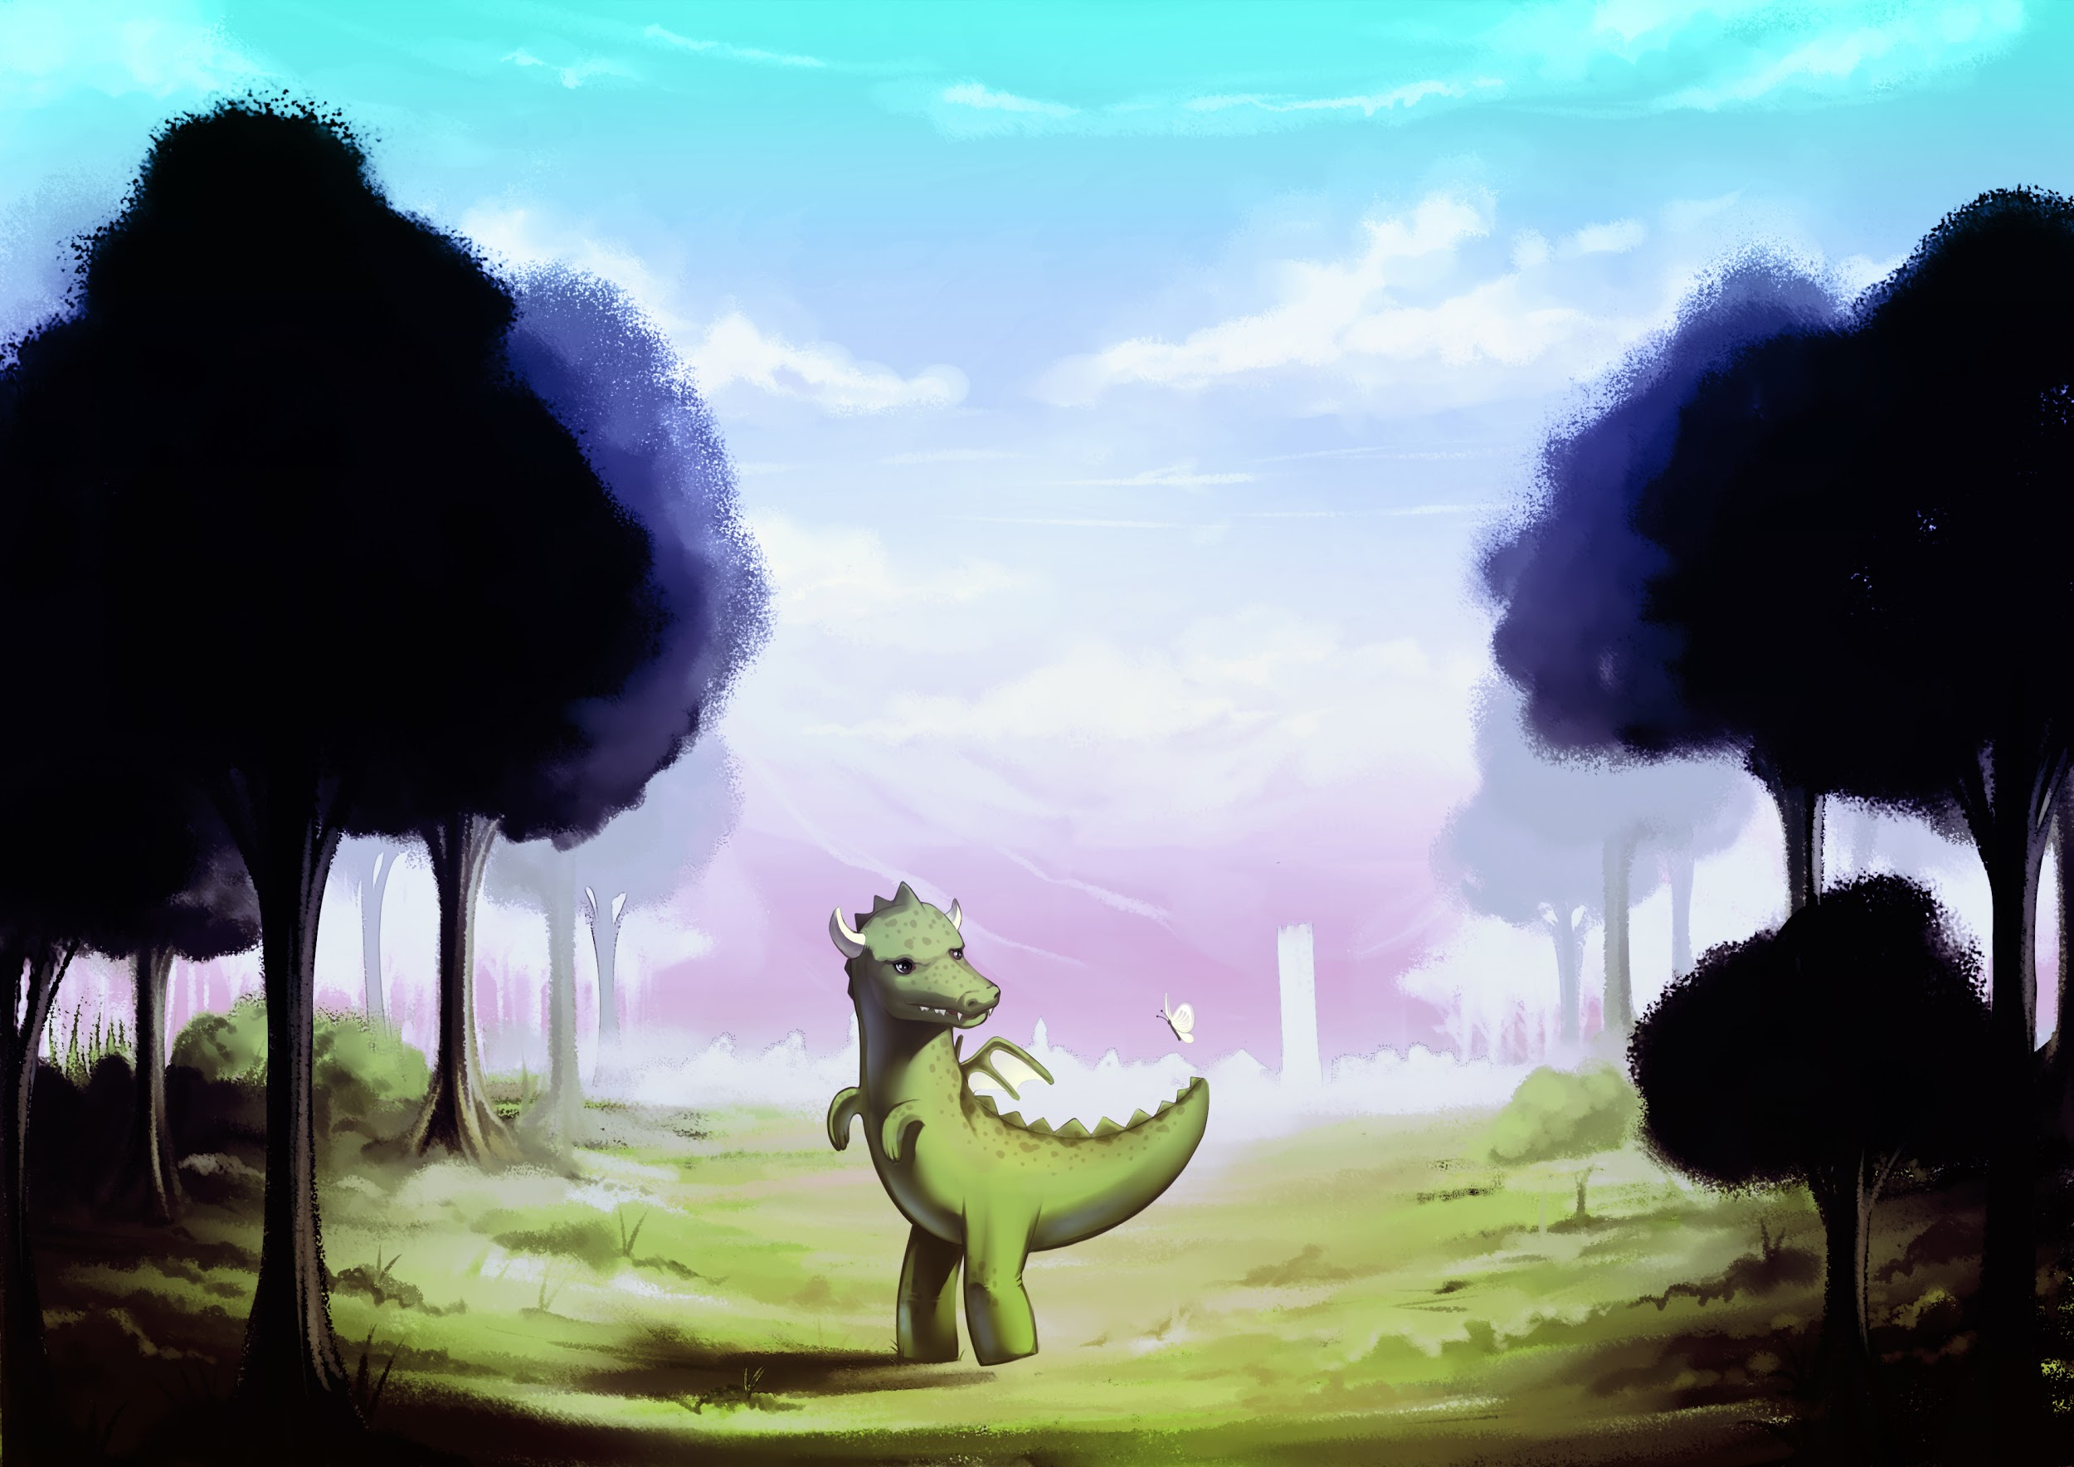
DragonTale

Slide 2
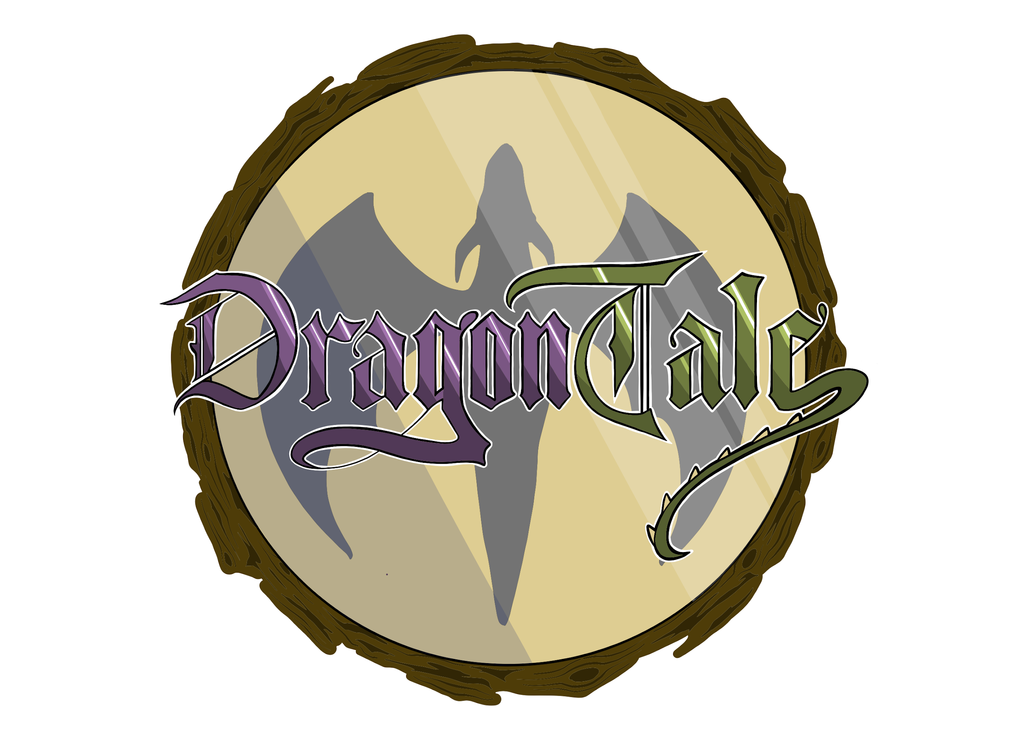
What is DragonTale?
DragonTale is a RPG and Adventure game that tells the story of a dragon and its mission to save the princess from an evil prince. In order to achieve this, he must battle enemies in turn-based combats. Additionally, the player can find items that tell more about the story.

Slide 3
How was Dragontale made?
Dragontale was developed by ten members, four for programming, four for graphical assets and two for audio assets:
Programming:
Andreia Rodrigues
Eduardo Leite
Francisco Queirós
Ka Chon Ho
Graphical Assets:
Diana Ferreira
Filipe Campos
Inês Ferraz
Tânia Carneiro
Audio Assets:
Bruno Marques
Renato Martinho
The environment used was the Unity game engine.

Slide 4
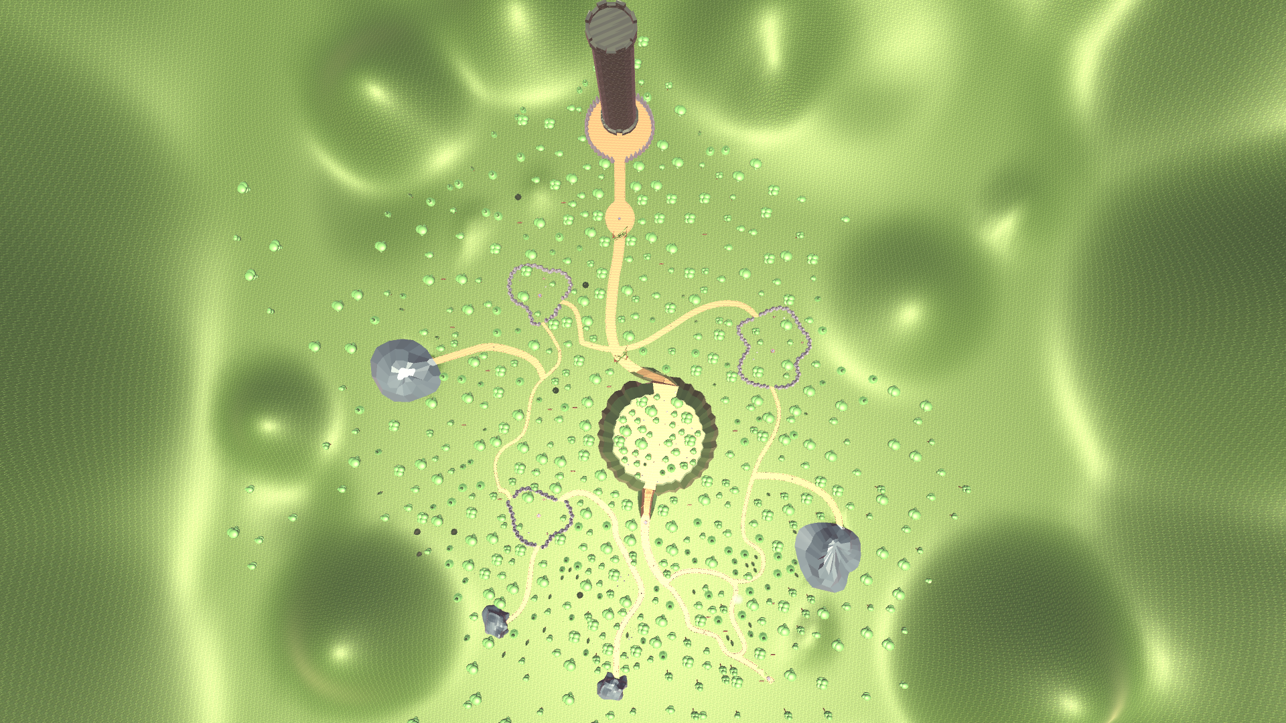

Slide 5
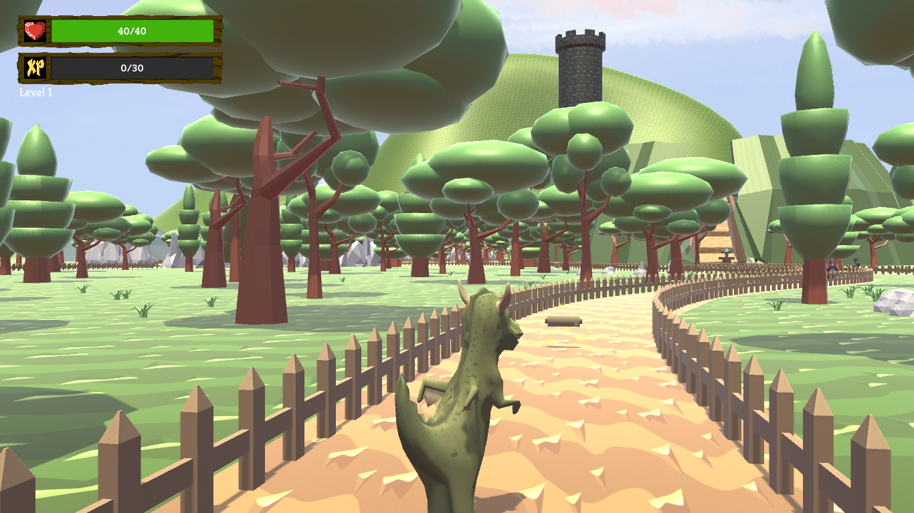

Slide 6
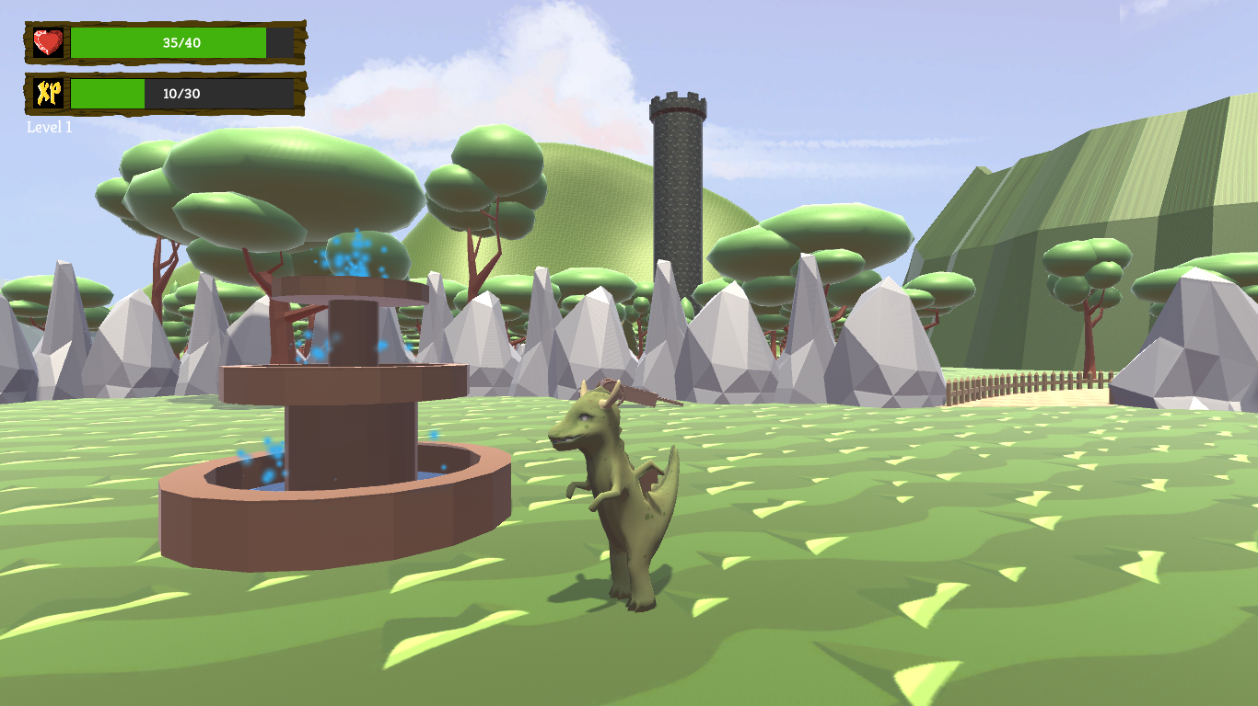

Slide 7
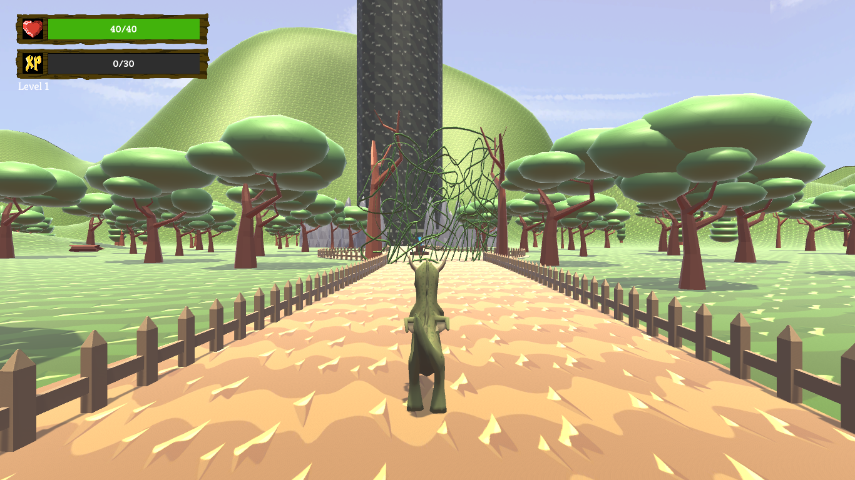

Slide 8
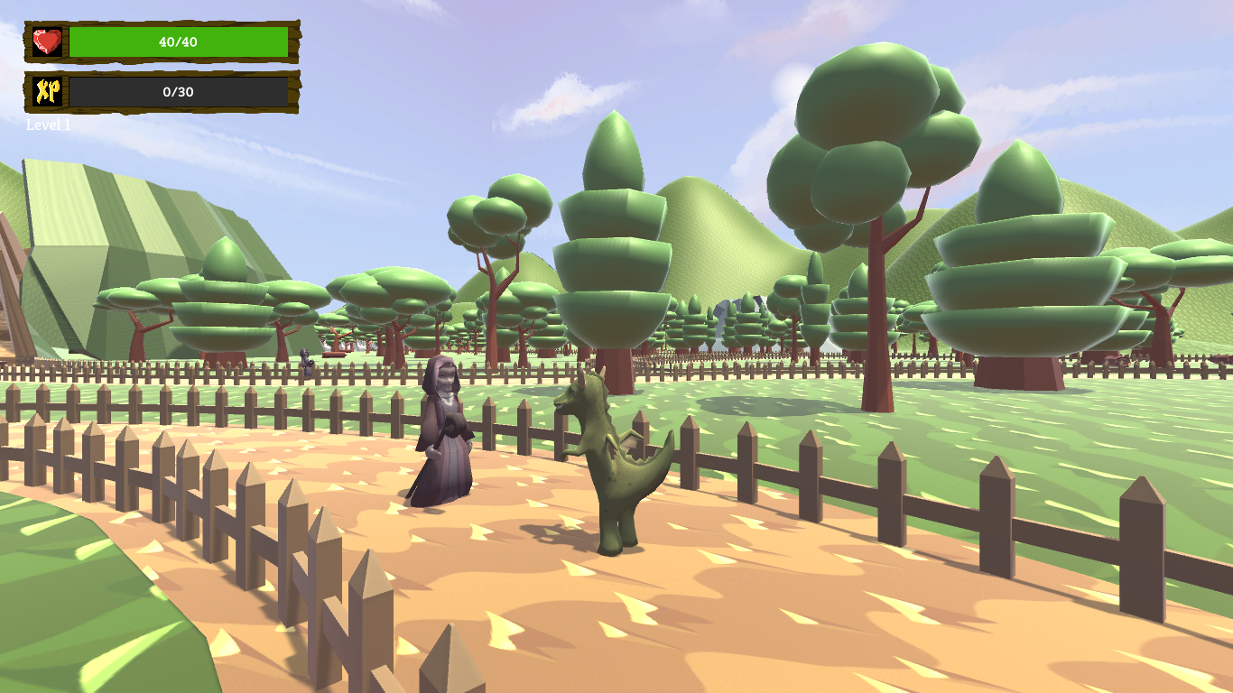

Slide 9
